Slide 1
Numerical Algorithms
Slides for Parallel Programming Techniques & Applications Using Networked Workstations & Parallel Computers 2nd ed., by B. Wilkinson & M. Allen,
@ 2004 Pearson Education Inc. All rights reserved.

Slide 2
Numerical Algorithms
In textbook do:
• Matrix multiplication
• Solving a system of linear equations
Slides for Parallel Programming Techniques & Applications Using Networked Workstations & Parallel Computers 2nd ed., by B. Wilkinson & M. Allen,
@ 2004 Pearson Education Inc. All rights reserved.

Slide 3
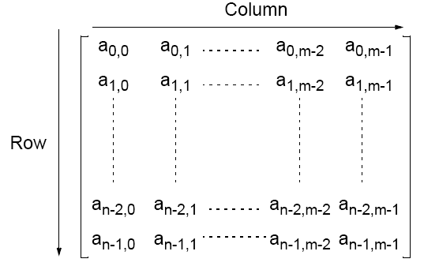
Matrices — A Review
An n x m matrix
Slides for Parallel Programming Techniques & Applications Using Networked Workstations & Parallel Computers 2nd ed., by B. Wilkinson & M. Allen,
@ 2004 Pearson Education Inc. All rights reserved.

Slide 4
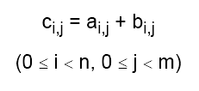
Matrix Addition
Involves adding corresponding elements of each matrix to form the result matrix.
Given the elements of A as ai,j and the elements of B as bi,j, each element of C is computed as
Slides for Parallel Programming Techniques & Applications Using Networked Workstations & Parallel Computers 2nd ed., by B. Wilkinson & M. Allen,
@ 2004 Pearson Education Inc. All rights reserved.

Slide 5

Matrix Multiplication
Multiplication of two matrices, A and B, produces the matrix C
whose elements, ci,j (0 <= i < n, 0 <= j < m), are computed as follows:
两个矩阵的乘法
where A is an n x l matrix and B is an l x m matrix.
Slides for Parallel Programming Techniques & Applications Using Networked Workstations & Parallel Computers 2nd ed., by B. Wilkinson & M. Allen,
@ 2004 Pearson Education Inc. All rights reserved.

Slide 6
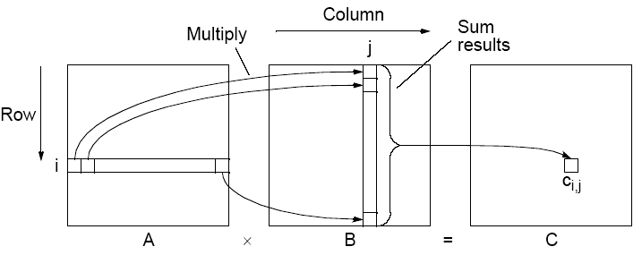
Matrix multiplication, C = A x B
Slides for Parallel Programming Techniques & Applications Using Networked Workstations & Parallel Computers 2nd ed., by B. Wilkinson & M. Allen,
@ 2004 Pearson Education Inc. All rights reserved.

Slide 7
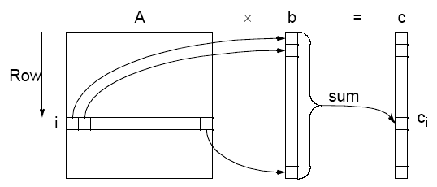
Matrix-Vector Multiplication
c = A x b
矩阵-向量乘法直接遵循矩阵-矩阵乘法的定义，通过使B为n x1矩阵(向量)。结果得到一个nx1矩阵(向量)。
Slides for Parallel Programming Techniques & Applications Using Networked Workstations & Parallel Computers 2nd ed., by B. Wilkinson & M. Allen,
@ 2004 Pearson Education Inc. All rights reserved.

Slide 8
Relationship of Matrices to Linear Equations
A system of linear equations can be written in matrix form:
一个线性方程组可以写成矩阵形式:
Ax = b
Matrix A holds a constants
x is a vector of the unknowns
b is a vector of the b constants.
Slides for Parallel Programming Techniques & Applications Using Networked Workstations & Parallel Computers 2nd ed., by B. Wilkinson & M. Allen,
@ 2004 Pearson Education Inc. All rights reserved.

Slide 9
Implementing Matrix Multiplication
Sequential Code
假设整个矩阵都是方阵(n x n个矩阵)。计算A x B的顺序代码可以很简单
for (i = 0; i < n; i++)
for (j = 0; j < n; j++) {
c[i][j] = 0;
for (k = 0; k < n; k++)
c[i][j] = c[i][j] + a[i][k] * b[k][j];
}
This algorithm requires n3 multiplications and n3 additions, leading to a sequential time complexity of O(n3).
该算法需要n3乘法和n3加法，导致O(n3)的时序复杂度。
Very easy to parallelize.
Slides for Parallel Programming Techniques & Applications Using Networked Workstations & Parallel Computers 2nd ed., by B. Wilkinson & M. Allen,
@ 2004 Pearson Education Inc. All rights reserved.

Slide 10
Parallel Code
With n processors (and n x n matrices), can obtain:
使用n个处理器的时间复杂度： O(n2)
内部循环的每个实例都是独立的，可以由单独的处理器完成
• Time complexity of O(n) with n2 processors
分配给每个处理器A和B的一个元素
成本最优 由于 O(n3) = n x O(n2) = n2 x O(n).
• Time complexity of O(log n) with n3 processors
By parallelizing the inner loop. Not cost-optimal since
O(n3)¹n3xO(log n)).
O(log n)并行矩阵乘法的下界.
Slides for Parallel Programming Techniques & Applications Using Networked Workstations & Parallel Computers 2nd ed., by B. Wilkinson & M. Allen,
@ 2004 Pearson Education Inc. All rights reserved.

Slide 11
Partitioning into Submatrices
Suppose matrix divided into s² submatrices. Each submatrix has n/
s x n/s elements. Using notation Ap,q as submatrix in submatrix row
p and submatrix column q:
for (p = 0; p < s; p++)
for (q = 0; q < s; q++) {
C_{p,q} = 0; /* clear elements of submatrix */
for (r = 0; r < m; r++) /* submatrix multiplication &*/
C_{p,q} = C_{p,q} + A_{p,r} * B_{r,q}; /*add to accum. submatrix*/
}
The line
C_{p,q} = C_{p,q} + A_{p,r} * B_{r,q};
means multiply submatrix Ap,r and Br,q using matrix multiplication
and add to submatrix Cp,q using matrix addition. Known as block
matrix multiplication.
Slides for Parallel Programming Techniques & Applications Using Networked Workstations & Parallel Computers 2nd ed., by B. Wilkinson & M. Allen,
@ 2004 Pearson Education Inc. All rights reserved.

Slide 12
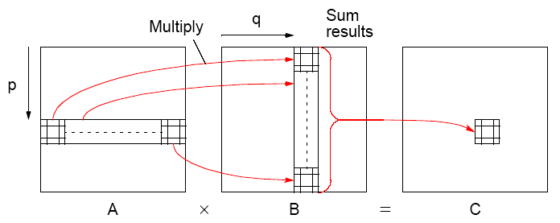
Block Matrix Multiplication
Slides for Parallel Programming Techniques & Applications Using Networked Workstations & Parallel Computers 2nd ed., by B. Wilkinson & M. Allen,
@ 2004 Pearson Education Inc. All rights reserved.

Slide 13
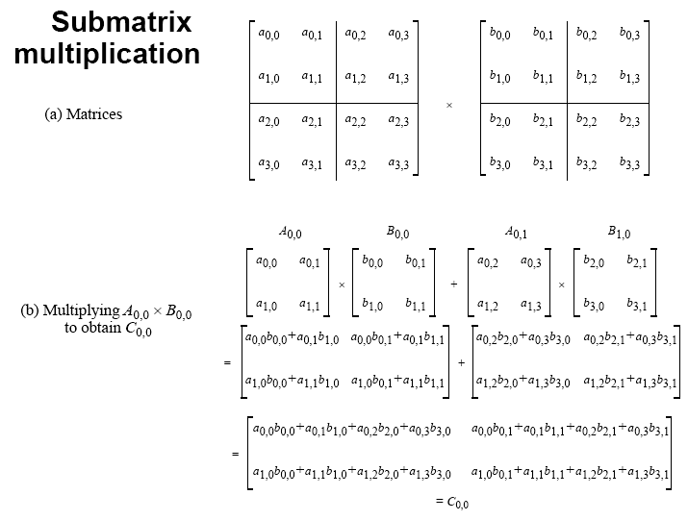
Slides for Parallel Programming Techniques & Applications Using Networked Workstations & Parallel Computers 2nd ed., by B. Wilkinson & M. Allen,
@ 2004 Pearson Education Inc. All rights reserved.

Slide 14
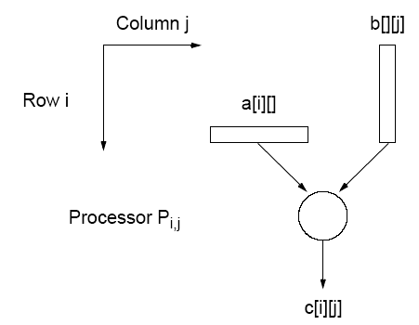
Direct Implementation
直接执行
One processor to compute each element of C – n^2 processors would be needed. One row of elements of A and one column of elements of B needed. Some of same elements sent to more than one processor. Can use submatrices.
需要一个处理器来计算C-n^2处理器的每个元素。需要A的一行元素和B的一列元素。一些相同的元素被发送给一个以上的处理器。可以使用子矩阵。
Slides for Parallel Programming Techniques & Applications Using Networked Workstations & Parallel Computers 2nd ed., by B. Wilkinson & M. Allen,
@ 2004 Pearson Education Inc. All rights reserved.

Slide 15
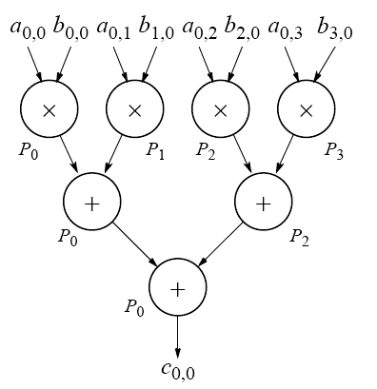
Performance Improvement
Using tree construction n numbers can be added in log n steps
using n processors:
使用n3处理器的O(log n)的计算时间复杂度。
Computational time
complexity of O(log n)
using n3 processors.
Slides for Parallel Programming Techniques & Applications Using Networked Workstations & Parallel Computers 2nd ed., by B. Wilkinson & M. Allen,
@ 2004 Pearson Education Inc. All rights reserved.

Slide 16
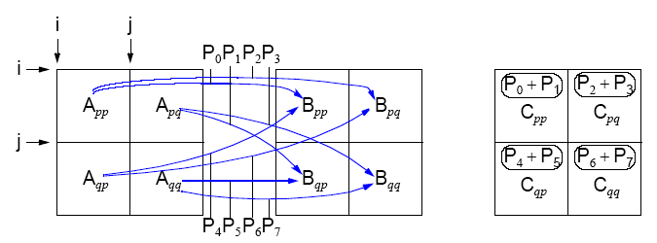
Recursive Implementation
递归执行
Apply same algorithm on each submatrix recursivly.
Excellent algorithm for a shared memory systems because of
locality of operations.
递归地对每个子矩阵应用相同的算法。
由于操作的局部性，这是共享内存系统的优秀算法。

Slide 17
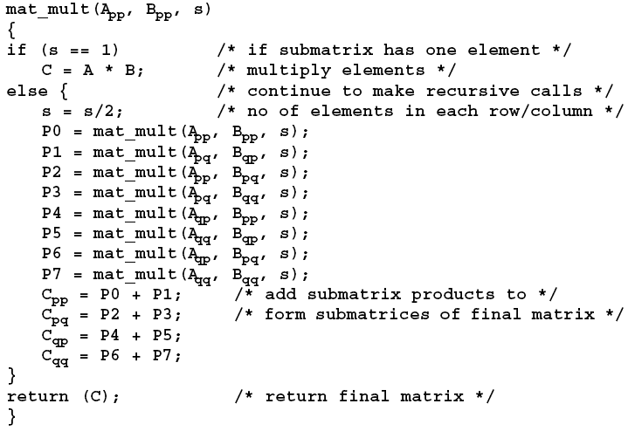
Recursive Algorithm
Slides for Parallel Programming Techniques & Applications Using Networked Workstations & Parallel Computers 2nd ed., by B. Wilkinson & M. Allen,
@ 2004 Pearson Education Inc. All rights reserved.

Slide 18
Mesh Implementations
• Cannon’s algorithm
• Fox’s algorithm (not in textbook but similar complexity)
• Systolic array
All involve using processor arranged a mesh and shifting elements of the arrays through the mesh. Accumulate the partial sums at each processor.
Mesh绑定
所有这些都涉及到使用处理器布置网格和通过网格移动数组元素。在每个处理器上累积部分和。
Slides for Parallel Programming Techniques & Applications Using Networked Workstations & Parallel Computers 2nd ed., by B. Wilkinson & M. Allen,
@ 2004 Pearson Education Inc. All rights reserved.

Slide 19
Mesh Implementations
Cannon’s Algorithm
Uses a mesh of processors with wraparound connections to shift the A
elements (or submatrices) left and the B elements (or submatrices) up.
使用带有环绕连接的处理器网格将a元素(或子矩阵)左移，将B元素(或子矩阵)向上移动。
1.初始处理器Pi,j有元素ai,j和bi,j (0 <= i < n, 0 <= k < n)。
2. 元素从它们的初始位置移动到“对齐”位置。的
A的第i行左移i个位置，第j列 B向上移动了j个位置。它的作用是放置元素ai j+i处理器Pi,j中的元素bi+j j。这些元素是其中的一对需要在ci,j的积累。
3.每个处理器，Pi,j，乘以它的元素。
4. A的第i行右移一位，B的第j列右移一位
一个地方向上。它的作用是把相邻的边连在一起
元素A和B，这也是积累中需要的。
5. 每个处理器，Pi,j，乘上所带来的元素，然后加上
结果是累加和。
6. 重复第4步和第5步，直到得到最终结果(n - 1移位
n行和n列的元素)。

Slide 20
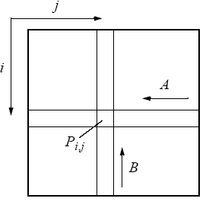
Movement of A and B elements
A和B元素的移动
Slides for Parallel Programming Techniques & Applications Using Networked Workstations & Parallel Computers 2nd ed., by B. Wilkinson & M. Allen,
@ 2004 Pearson Education Inc. All rights reserved.

Slide 21
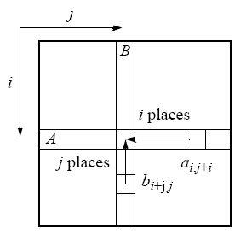
Step 2 — Alignment of elements of A and B
A和B元素的对齐
Slides for Parallel Programming Techniques & Applications Using Networked Workstations & Parallel Computers 2nd ed., by B. Wilkinson & M. Allen,
@ 2004 Pearson Education Inc. All rights reserved.

Slide 22
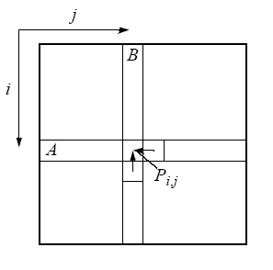
Step 4 - One-place shift of elements of A and B
A和B元素的单位置移位
Slides for Parallel Programming Techniques & Applications Using Networked Workstations & Parallel Computers 2nd ed., by B. Wilkinson & M. Allen,
@ 2004 Pearson Education Inc. All rights reserved.

Slide 23
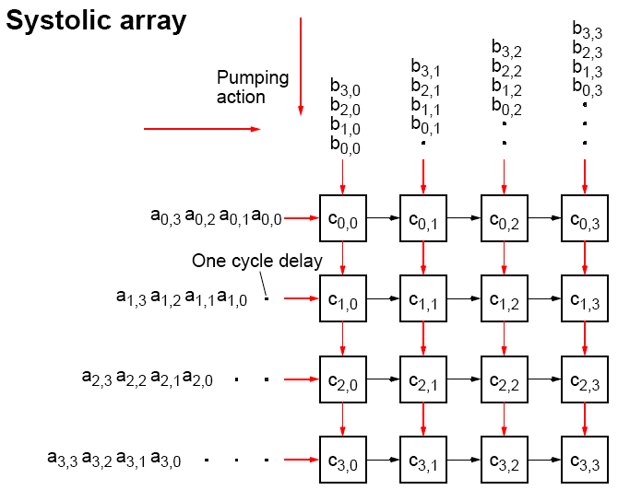
收缩压数组
Slides for Parallel Programming Techniques & Applications Using Networked Workstations & Parallel Computers 2nd ed., by B. Wilkinson & M. Allen,
@ 2004 Pearson Education Inc. All rights reserved.

Slide 24
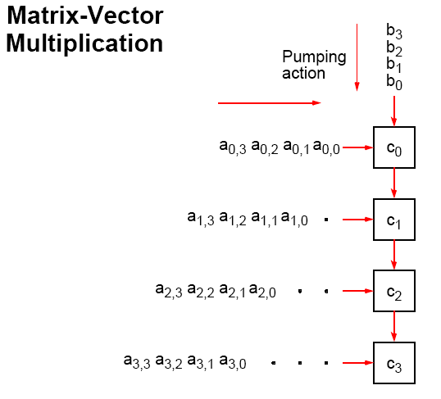
矩阵向量乘法
Slides for Parallel Programming Techniques & Applications Using Networked Workstations & Parallel Computers 2nd ed., by B. Wilkinson & M. Allen,
@ 2004 Pearson Education Inc. All rights reserved.

Slide 25
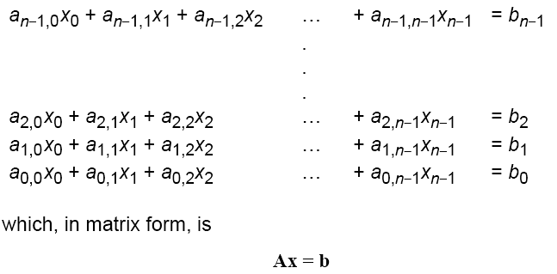
Solving a System of Linear Equations
解一个线性方程组
Objective is to find values for the unknowns, x0, x1, …, xn-1, given values for a0,0, a0,1, …, an-1,n-1, and b0, …, bn .
Slides for Parallel Programming Techniques & Applications Using Networked Workstations & Parallel Computers 2nd ed., by B. Wilkinson & M. Allen,
@ 2004 Pearson Education Inc. All rights reserved.

Slide 26
Solving a System of Linear Equations
.稀疏矩阵
Dense matrices
Gaussian Elimination - parallel time complexity O(n2)
Sparse matrices稀疏矩阵
By iteration - depends upon iteration method and number of
iterations but typically O(log n)
通过迭代——取决于迭代方法和迭代次数，但通常是O(log n)
• Jacobi iteration
• Gauss-Seidel relaxation (not good for parallelization)
• Red-Black ordering
• Multigrid
解一个线性方程组
Slides for Parallel Programming Techniques & Applications Using Networked Workstations & Parallel Computers 2nd ed., by B. Wilkinson & M. Allen,
@ 2004 Pearson Education Inc. All rights reserved.

Slide 27

Gaussian Elimination
Convert general system of linear equations into triangular system of equations. Then be solved by Back Substitution.
将一般的线性方程组转化为三角形方程组。然后用回代入法求解。
Uses characteristic of linear equations that any row can be replaced by that row added to another row multiplied by a constant.
利用线性方程的特点，任何一行都可以被这一行加上另一行乘以一个常数来代替。
Starts at the first row and works toward the bottom row. At the ith row, each row j below the ith row is replaced by row j + (row i) (-aj,i/ ai,i). The constant used for row j is -aj,i/ai,i. Has the effect of making all the elements in the ith column below the ith row zero because
Slides for Parallel Programming Techniques & Applications Using Networked Workstations & Parallel Computers 2nd ed., by B. Wilkinson & M. Allen,
@ 2004 Pearson Education Inc. All rights reserved.

Slide 28
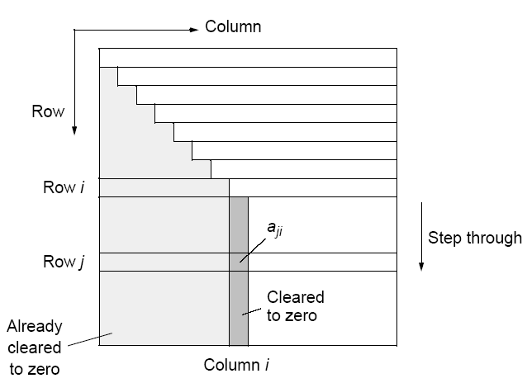
Gaussian elimination
Slides for Parallel Programming Techniques & Applications Using Networked Workstations & Parallel Computers 2nd ed., by B. Wilkinson & M. Allen,
@ 2004 Pearson Education Inc. All rights reserved.

Slide 29
Partial Pivoting
If ai,i is zero or close to zero, we will not be able to compute the
quantity -aj,i/ai,i.
如果ai i是0或者接近0，我们就无法计算出aj i。
Procedure must be modified into so-called partial pivoting by swapping the ith row with the row below it that has the largest absolute element in the ith column of any of the rows below the ith
row if there is one. (Reordering equations will not affect the system.)
必须将过程修改为所谓的部分枢轴，方法是将第i行与它下面的行交换，如果第i行以下的行中有较大的绝对元素，则第i行与第i行之间的第i列中有绝对元素。(重新排序的方程不会影响系统。)
In the following, we will not consider partial pivoting.

Slide 30
Sequential Code
Without partial pivoting:
for (i = 0; i < n-1; i++) /* for each row, except last */
for (j = i+1; j < n; j++) { /*step thro subsequent rows */
m = a[j][i]/a[i][i]; /* Compute multiplier */
for (k = i; k < n; k++) /*last n-i-1 elements of row j*/
a[j][k] = a[j][k] - a[i][k] * m;
b[j] = b[j] - b[i] * m; /* modify right side */
}
The time complexity is O(n3).
Slides for Parallel Programming Techniques & Applications Using Networked Workstations & Parallel Computers 2nd ed., by B. Wilkinson & M. Allen,
@ 2004 Pearson Education Inc. All rights reserved.

Slide 31
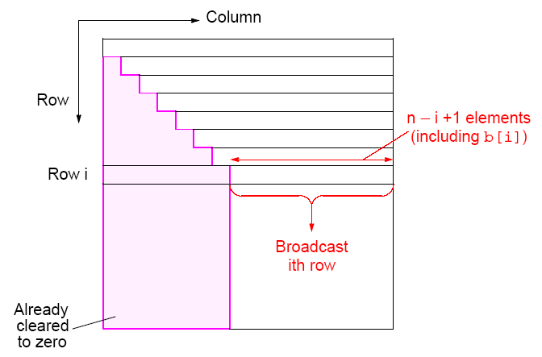
Parallel Implementation
Slides for Parallel Programming Techniques & Applications Using Networked Workstations & Parallel Computers 2nd ed., by B. Wilkinson & M. Allen,
@ 2004 Pearson Education Inc. All rights reserved.

Slide 32
Analysis
Communication
n - 1 broadcasts performed sequentially. ith broadcast contains n -
i + 1 elements.
Time complexity of O(n2) ( see textbook)
Computation
After row broadcast, each processor Pj beyond broadcast processor Pi will compute its multiplier, and operate upon n - j + 2 elements of its row. Ignoring the computation of the multiplier, there are n - j + 2 multiplications and n - j + 2 subtractions.
Time complexity of O(n2) (see textbook).
Efficiency will be relatively low because all the processors before the processor holding row i do not participate in the computation again.
Slides for Parallel Programming Techniques & Applications Using Networked Workstations & Parallel Computers 2nd ed., by B. Wilkinson & M. Allen,
@ 2004 Pearson Education Inc. All rights reserved.

Slide 33
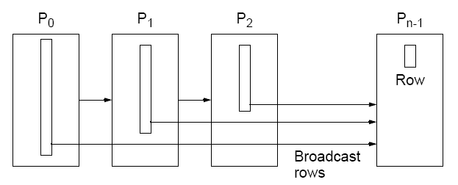
Pipeline implementation of Gaussian elimination
Slides for Parallel Programming Techniques & Applications Using Networked Workstations & Parallel Computers 2nd ed., by B. Wilkinson & M. Allen,
@ 2004 Pearson Education Inc. All rights reserved.

Slide 34
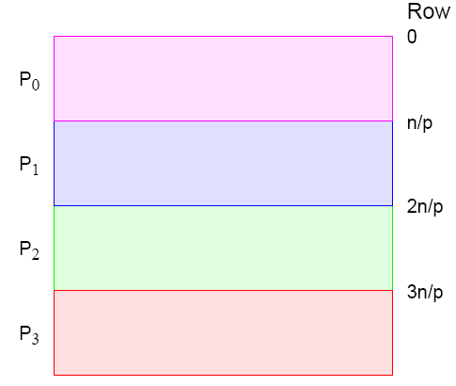
Strip Partitioning
Poor processor allocation! Processors do not participate in
computation after their last row is processed.
Slides for Parallel Programming Techniques & Applications Using Networked Workstations & Parallel Computers 2nd ed., by B. Wilkinson & M. Allen,
@ 2004 Pearson Education Inc. All rights reserved.

Slide 35
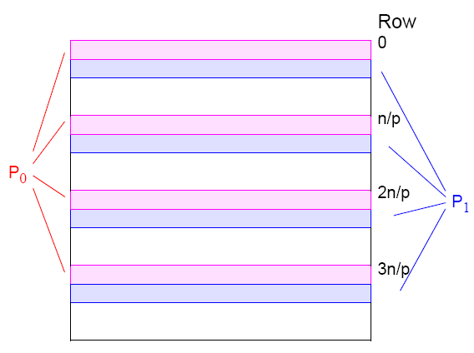
Cyclic-Striped Partitioning
An alternative which equalizes the processor workload:
一种均衡处理器工作量的替代方案:
Slides for Parallel Programming Techniques & Applications Using Networked Workstations & Parallel Computers 2nd ed., by B. Wilkinson & M. Allen,
@ 2004 Pearson Education Inc. All rights reserved.

Slide 36
Iterative Methods
Time complexity of direct method at O(N2) with N processors, is
significant.
Time complexity of iteration method depends upon:
• the type of iteration,
• number of iterations
• number of unknowns, and
• required accuracy
but can be less than the direct method especially for a few
unknowns i.e a sparse system of linear equations.
Slides for Parallel Programming Techniques & Applications Using Networked Workstations & Parallel Computers 2nd ed., by B. Wilkinson & M. Allen,
@ 2004 Pearson Education Inc. All rights reserved.

Slide 37
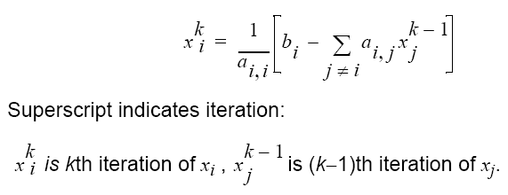
Jacobi Iteration
Iteration formula - ith equation rearranged to have ith unknown on
left side:
迭代公式-左侧重新排列第i个方程，第i个未知数:
Slides for Parallel Programming Techniques & Applications Using Networked Workstations & Parallel Computers 2nd ed., by B. Wilkinson & M. Allen,
@ 2004 Pearson Education Inc. All rights reserved.

Slide 38
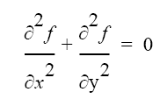
Example of a Sparse System of Linear Equations
Laplace’s Equation
Solve for f over the two-dimensional x-y space.
For a computer solution, finite difference methods are appropriate
Two-dimensional solution space is “discretized” into a large number of solution points.
Slides for Parallel Programming Techniques & Applications Using Networked Workstations & Parallel Computers 2nd ed., by B. Wilkinson & M. Allen,
@ 2004 Pearson Education Inc. All rights reserved.

Slide 39
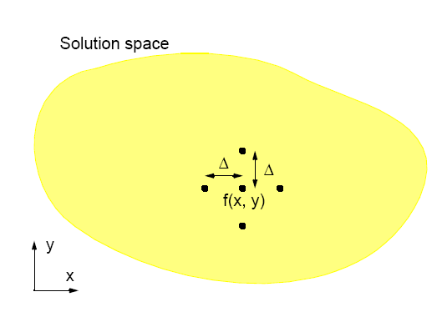
Finite Difference Method
Slides for Parallel Programming Techniques & Applications Using Networked Workstations & Parallel Computers 2nd ed., by B. Wilkinson & M. Allen,
@ 2004 Pearson Education Inc. All rights reserved.

Slide 40
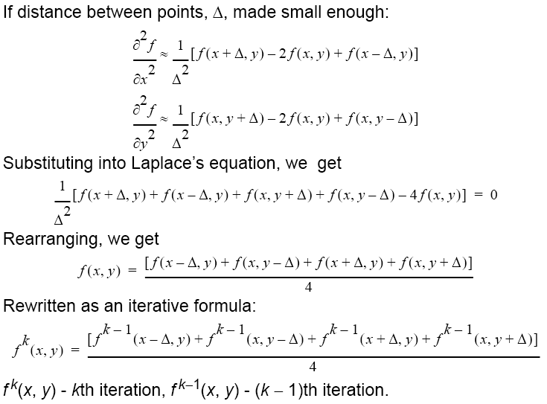
如果点与点之间的距离A足够小:
代入拉普拉斯方程，得到
Slides for Parallel Programming Techniques & Applications Using Networked Workstations & Parallel Computers 2nd ed., by B. Wilkinson & M. Allen,
@ 2004 Pearson Education Inc. All rights reserved.

Slide 41
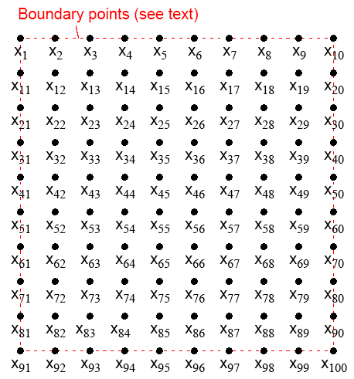
Natural Order
Slides for Parallel Programming Techniques & Applications Using Networked Workstations & Parallel Computers 2nd ed., by B. Wilkinson & M. Allen,
@ 2004 Pearson Education Inc. All rights reserved.

Slide 42
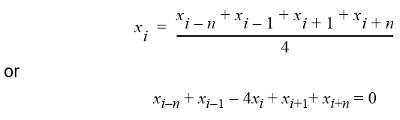

Relationship with a General System of Linear Equations
利用自然排序，由第i个方程计算出第i个点:
Using natural ordering, ith point computed from ith equation:
which is a linear equation with five unknowns (except those with boundary points).
In general form, the ith equation becomes:
Slides for Parallel Programming Techniques & Applications Using Networked Workstations & Parallel Computers 2nd ed., by B. Wilkinson & M. Allen,
@ 2004 Pearson Education Inc. All rights reserved.

Slide 43
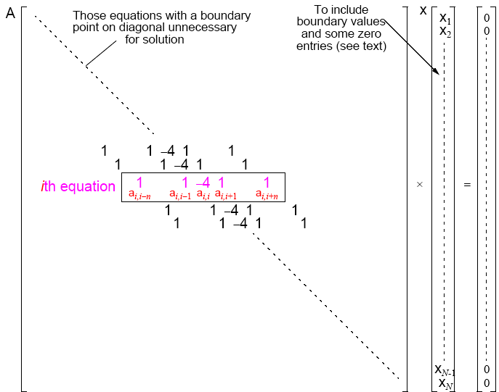
Slides for Parallel Programming Techniques & Applications Using Networked Workstations & Parallel Computers 2nd ed., by B. Wilkinson & M. Allen,
@ 2004 Pearson Education Inc. All rights reserved.

Slide 44
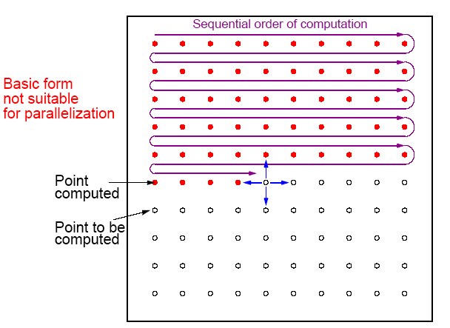
Gauss-Seidel Relaxation
Uses some newly computed values to compute other values in that iteration.
Slides for Parallel Programming Techniques & Applications Using Networked Workstations & Parallel Computers 2nd ed., by B. Wilkinson & M. Allen,
@ 2004 Pearson Education Inc. All rights reserved.

Slide 45


Gauss-Seidel Iteration Formula
where the superscript indicates the iteration.
With natural ordering of unknowns, formula reduces to
At the kth iteration, two of the four values (before the ith element)
taken from the kth iteration and two values (after the ith element)
taken from the (k-1)th iteration. We have:
Slides for Parallel Programming Techniques & Applications Using Networked Workstations & Parallel Computers 2nd ed., by B. Wilkinson & M. Allen,
@ 2004 Pearson Education Inc. All rights reserved.

Slide 46
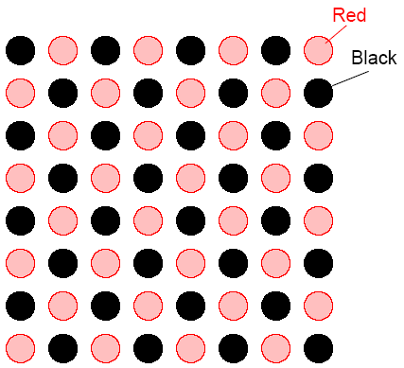
Red-Black Ordering
First, black points computed. Next, red points computed. Black
points computed simultaneously, and red points computed
simultaneously.
Slides for Parallel Programming Techniques & Applications Using Networked Workstations & Parallel Computers 2nd ed., by B. Wilkinson & M. Allen,
@ 2004 Pearson Education Inc. All rights reserved.

Slide 47
Red-Black Parallel Code
forall (i = 1; i < n; i++)
forall (j = 1; j < n; j++)
if ((i + j) % 2 == 0) /* compute red points */
f[i][j] = 0.25*(f[i-1][j] + f[i][j-1] + f[i+1][j] + f[i][j+1]);
forall (i = 1; i < n; i++)
forall (j = 1; j < n; j++)
if ((i + j) % 2 != 0) /* compute black points */
f[i][j] = 0.25*(f[i-1][j] + f[i][j-1] + f[i+1][j] + f[i][j+1]);
Slides for Parallel Programming Techniques & Applications Using Networked Workstations & Parallel Computers 2nd ed., by B. Wilkinson & M. Allen,
@ 2004 Pearson Education Inc. All rights reserved.

Slide 48
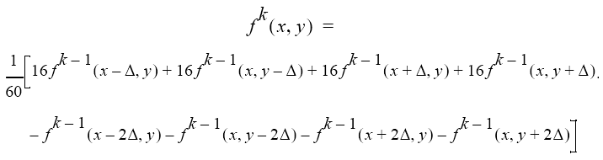
Higher-Order Difference Methods
More distant points could be used in the computation. The following update formula:
Slides for Parallel Programming Techniques & Applications Using Networked Workstations & Parallel Computers 2nd ed., by B. Wilkinson & M. Allen,
@ 2004 Pearson Education Inc. All rights reserved.

Slide 49
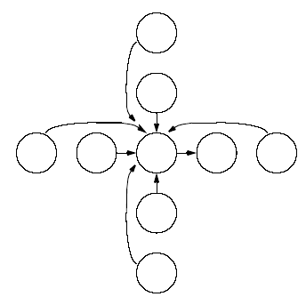
Nine-point stencil
Slides for Parallel Programming Techniques & Applications Using Networked Workstations & Parallel Computers 2nd ed., by B. Wilkinson & M. Allen,
@ 2004 Pearson Education Inc. All rights reserved.

Slide 50
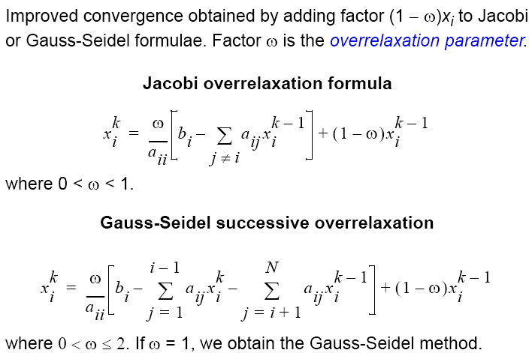
Overrelaxation
Slides for Parallel Programming Techniques & Applications Using Networked Workstations & Parallel Computers 2nd ed., by B. Wilkinson & M. Allen,
@ 2004 Pearson Education Inc. All rights reserved.

Slide 51
Multigrid Method
First, a coarse grid of points used. With these points, iteration process will start to converge quickly.
At some stage, number of points increased to include points of the
coarse grid and extra points between the points of the coarse grid.
Initial values of extra points found by interpolation. Computation continues with this finer grid.
Grid can be made finer and finer as computation proceeds, or computation can alternate between fine and coarse grids.
Coarser grids take into account distant effects more quickly and provide a good starting point for the next finer grid.
Slides for Parallel Programming Techniques & Applications Using Networked Workstations & Parallel Computers 2nd ed., by B. Wilkinson & M. Allen,
@ 2004 Pearson Education Inc. All rights reserved.

Slide 52
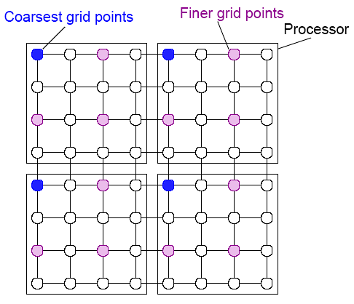
Multigrid processor allocation
Slides for Parallel Programming Techniques & Applications Using Networked Workstations & Parallel Computers 2nd ed., by B. Wilkinson & M. Allen,
@ 2004 Pearson Education Inc. All rights reserved.

Slide 53
（半）异步迭代
(Semi) Asynchronous Iteration
As noted early, synchronizing on every iteration will cause significant overhead - best if one can is to synchronize after a
number of iterations.
Slides for Parallel Programming Techniques & Applications Using Networked Workstations & Parallel Computers 2nd ed., by B. Wilkinson & M. Allen,
@ 2004 Pearson Education Inc. All rights reserved.

